Slide 1
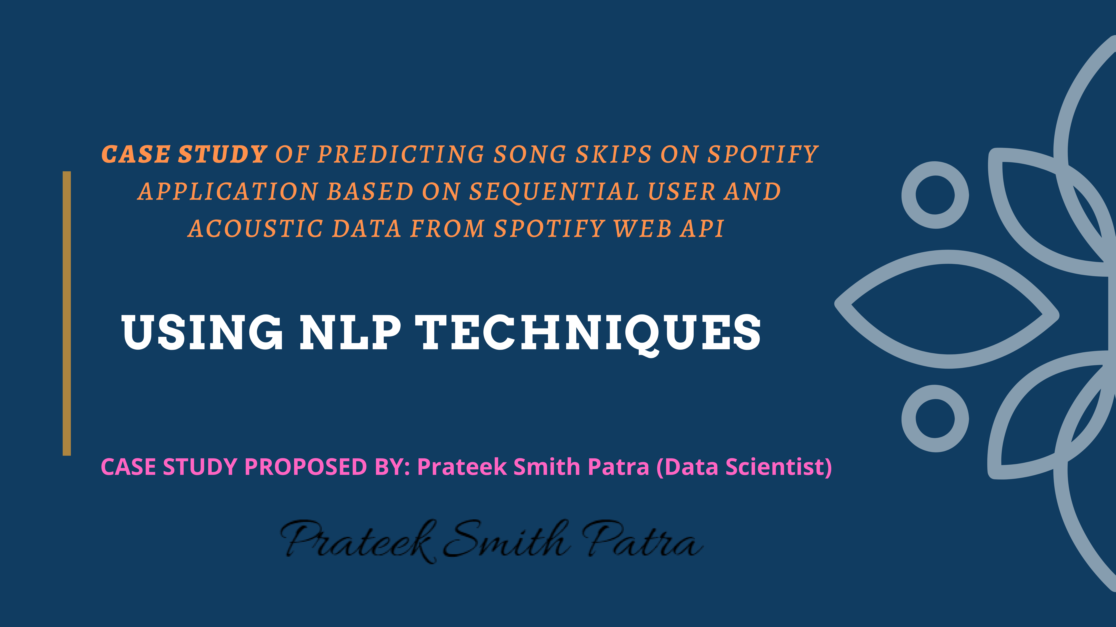

Slide 2
Project Title: Using NLP techniques to predict song skips on Spotify Application based on sequential user and acoustic data
Aim Of Project:
Build a ML model that will predict if a user will skip a song or not given information about the user’s previous actions during a listening session along with acoustic features of the previous songs. Model to predict if a user will skip over a track based on the user’s interactions with previous songs and the song’s musical qualities in an individual music listening session.

Slide 3
Introduction
Music consumption habits have changed dramatically with the rise of streaming services like Spotify, Apple Music, and Tidal. The skip button plays a large role in the user’s experience, as they are free to abandon songs as they choose. Music providers are also incentivized to recommend songs that their users like in order to increase user experience and time spent on the platform.
Machine learning in the context of music often uses recommender system. There hasn’t been much research on how a user’s interaction with music over time can help recommend music to the user.
Skipping behavior serves as a powerful signal about what the user does and doesn't like. Being able to use skip behavior in the context of an entire listening session is key to recommend relevant content. We will implement simpler sequential-based models like GBTs, LSTMs, and Bi-LSTMS, as well as applied NLP techniques to our task.
Spotify has provided 130 million listening sessions for training for this challenge. Another 30 million sessions are provided as the test set[1]. Each session is divided into two nearly equal halves, with the information about tracks available for both halves of a session. However, the user interaction features are available only for the first half6. The task is to predict if the user skipped any of the tracks in the second half.
The length of each session varies from 10 to 20 tracks. This means the model has to predict skipping behavior for five tracks for the shortest sessions, and ten tracks for the longest. Metadata such as duration, release year, and US popularity estimate is provided for every track. Also, audio features such as acousticness, tempo, loudness are provided. For each track that the user was presented within the session, interactions such as seek forward/backward, short/long pause before play are available. Finally, session information such as the time of the day, date, premium user or not, context type of playlist is present

Slide 4
Related Work
Concatenating the acoustic and behavior features of the first 10 tracks with the acoustic feature of the second 10 and sending this concatenation through several convolutional layers as well as a self attention layer to output the predictions for tracks 10-20.
NLP perform well on sequential prediction tasks. The Transformer revolutionized the world of NLP through the introduction of attention mechanisms, replacing recurrences and convolutions
Many of these NLP approaches for generating a sequence from a sequence use an encoder and/or decoder. In our project, we also use this encoder and decoder structure, as well as attention mechanisms to generate context-aware predictions for skip behavior in a given Spotify listening session.
Session-based music recommender systems specifically try to infer user’s preferences and context using information from a single session.
NLP tools and approaches
Python and the Natural Language Toolkit (NLTK)
The Python programing language provides a wide range of tools and libraries for attacking specific NLP tasks. Many of these are found in the Natural Language Toolkit, or NLTK, an open source collection of libraries, programs, and education resources for building NLP programs.
Statistical NLP, machine learning, and deep learning
The earliest NLP applications were hand-coded, rules-based systems that could perform certain NLP tasks, but couldn't easily scale to accommodate a seemingly endless stream of exceptions or the increasing volumes of text and voice data.

Slide 5
What is natural language processing?
Natural language processing (NLP) refers to the branch of computer science—and more specifically, the branch of artificial intelligence or AI—concerned with giving computers the ability to understand text and spoken words in much the same way human beings can.
NLP combines computational linguistics—rule-based modeling of human language—with statistical, machine learning, and deep learning models. Together, these technologies enable computers to process human language in the form of text or voice data and to ‘understand’ its full meaning, complete with the speaker or writer’s intent and sentiment.
NLP drives computer programs that translate text from one language to another, respond to spoken commands, and summarize large volumes of text rapidly—even in real time. There’s a good chance you’ve interacted with NLP in the form of voice-operated GPS systems, digital assistants, speech-to-text dictation software, customer service chatbots, and other consumer conveniences. But NLP also plays a growing role in enterprise solutions that help streamline business operations, increase employee productivity, and simplify mission-critical business processes.

Slide 6
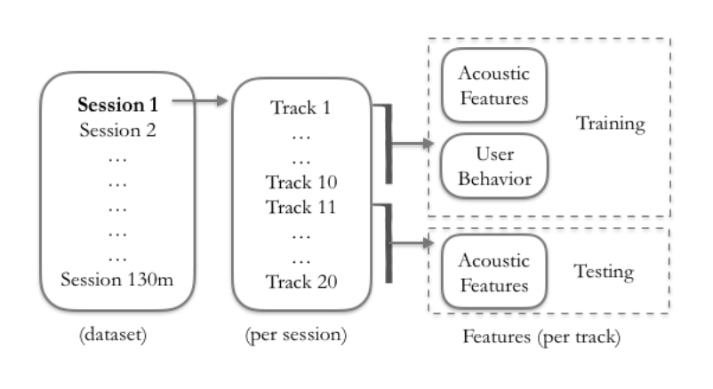
Dataset and Features
Dataset: Spotify Sequential Skip Prediction dataset [2], consisting of roughly 130 million listening sessions with associated user behaviors. Each session consists of multiple music tracks (songs, podcasts, etc.). User interaction features are provided for the first half of the session, but only track ids are provided for the second half.
We are using the Spotify Sequential Skip Prediction dataset for our project (Brost et al., 2019), which consists of roughly 130 million listening sessions. Each session has at most 20 music tracks
All the user behavior features and track ids are provided for the first half of the session, but only the track ids are provided for the second half
The track ids are associated with the track’s acoustic features that can be extracted via the Spotify API. The user behavior features consist of actions like whether the user paused, hour of day, etc. and acoustic features consist of data like danceability, tempo, etc.

Slide 7
Data Preprocessing
Pre-Processing:
Merging user behavior and acoustic features for each track using the track ids. Preprocessing the categorical features into onehot representations and normalized them into (z-score and min/max). This preprocessing created an input track embedding for our model for better prediction.
Features Details:
We will chose to use ‘skip_2’ as our output label for whether the song was skipped/not skipped since it better represents whether a user likes the track they are on.
In the dataset, skipping behavior is classified into four types:
(1) skip_1: Boolean indicating if the track was only played very briefly
(2) skip_2: Boolean indicating if the track was only played briefly
(3) skip_3: Boolean indicating if most of the track was played
(4) not_skipped: Boolean indicating that the track was played in its entirety

Slide 8
Methods
(A) Preliminary Baseline: Gradient Boosted Tree
Gradient Boosted Trees (GBT) algorithm as our baseline because the boosting method in GBT generates predictors sequentially and builds off of previous data (Zhang & Haghani, 2015); i.e. the idea of Gradient Boosted trees is to improve upon the predictions of the first tree in order to build the second tree, and so on. It follows sequence-based classification where we want to build a model for each track we are predicting based on the previous track. Light GBT is used because of its high speed, low memory & capacity of handling large datasets.
(B) Recurrent Neural Baselines: LSTM and Bi-LSTM
This architecture uses two separate recurrent neural models, the first to encode the inputs into a single high-dimensional state, and the second to decode the state passed from the encoder towards the defined prediction task.
This encoder-decoder architecture to train and evaluate on our sequence-to-sequence skip prediction task

Slide 9
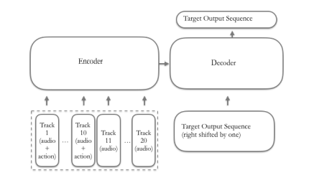
(C) Transformer: Traditional NLP Method
Transformers were able to learn long and short-range dependencies in a way that LSTMs and RNNs could not, which is especially important in our dataset because when trying to predict skip/no skip for a certain track, it is important to take into account the audio features for all the previous tracks as well as historical skip behavior.
Technique:
We will develop a meaningful embedding of the user behavior and acoustic features for each track in the entire listening session. The embedding gets passed into our encoder, creating a hidden state, which gets passed into the decoder along with the output target sequence. The output target sequence that gets passed into the decoder is right-shifted by one so that the decoder uses the output prediction of the previous track and properly predicts in-sequence. We added a linear layer at the end of our transformer to map our predictions into our labels space.
Architecture of Traditional NLP Transformer

Slide 10
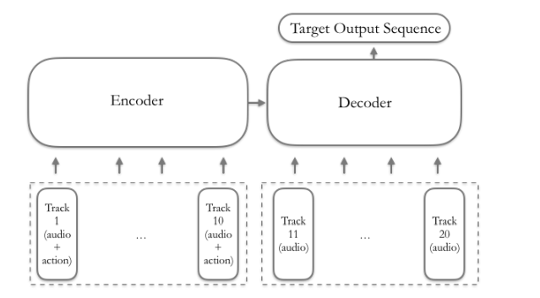
(D) Transformer: Feature-Forcing Method
The problem is unique in that only the second half of the input sequence (session) needs predictions, while the first half has ground truth labels we want to leverage in the second half’s predictions.
The encoder outputs a set of attention vectors K and V, which the decoder utilizes in the encoder decoder attention layer. This layer allows the decoder to learn which parts of the input sequence it should pay attention to. For our feature-forcing model, we fed only the first 10 tracks (with behavior and audio features) into the encoder, hypothesizing that the encoder would produce an output that meaningfully represents the relevant information from the first 10 tracks.
Architecture of our Feature-Forcing Transformer

Slide 11
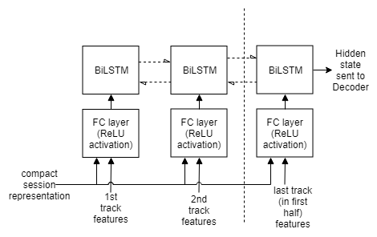
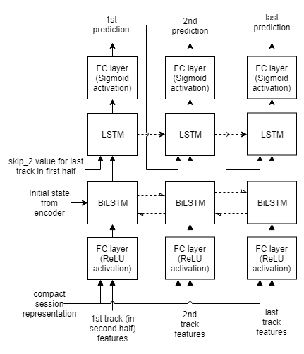
Encoder
At every track’s prediction, the Decoder now has easy access to a representation of the session from the input. Hence, the only goal of the Encoder currently is to create the initial state for the decoder. The Encoder consists of an FC layer and a subsequent BiLSTM layer.
Decoder
The track features of the second half along with fixed vector representation of the session is first sent to an FC layer with ReLU non-linearity. The purpose of this layer can be seen as a context setting mechanism - the track features are being transformed using the current session as the context. Note that the weights of this FC layer are shared with that of the FC layer from the Encoder.

Slide 12
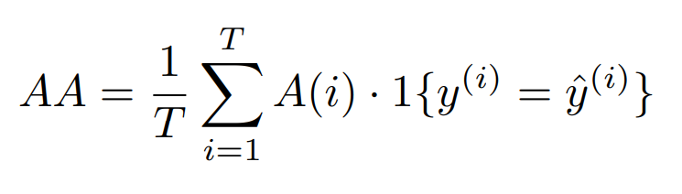
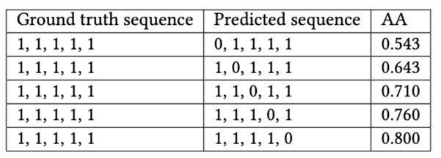
Experiments and Discussion
Accuracy Metric
The evaluation metric used in the original Spotify Sequential Skip Prediction Challenge is mean Average Accuracy (mAA or MAA). For a single example session i with T tracks, we can define Average Accuracy as
where y(i) is the ground truth label for track i, yˆ(i)
is the predicted label for track i, and A(i) is the accuracy of label predictions in the sequence up to and including the ith track.
Expected result of Average Accuracy (AA)is much different than that of conventional accuracy. This is because AA acts like a weighted sum of accuracy that places emphasis on correct classifications earlier in the sequence. Unlike conventional accuracy, AA
cannot achieve a value above 0.6 even if just the first label is misclassified

Slide 13
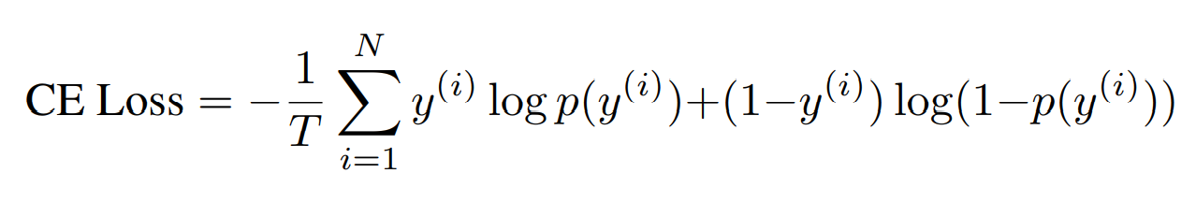
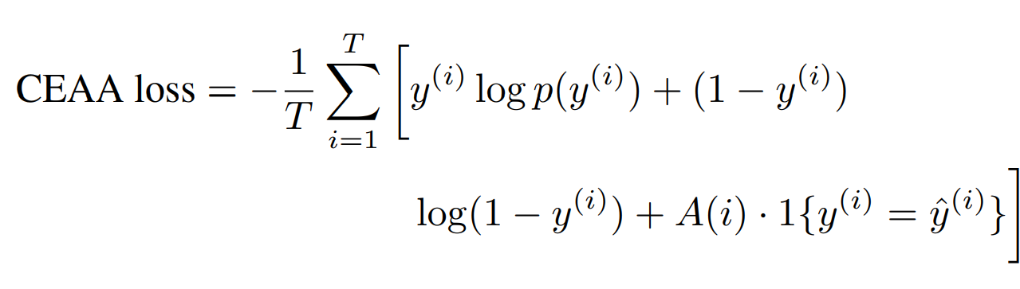
Loss Functions
Two kinds of loss functions are used to train our models. The first loss function explored was binary cross-entropy loss. For a single session with T tracks, we can define cross-entropy loss as
where y(i) is the ground truth label for track i and p(y(i)) is the predicted probability of track i being labeled positive.
Cross-entropy loss, while useful for maximizing accuracy generally, does not adequately maximize Average Accuracy. As a result, we defined an experimental loss function that combined aspects of minimizing cross-entropy loss while also maximizing Average Accuracy. For a single session with T tracks, this new loss function can be defined as
where y(i) is the ground truth label for track i, yˆ(i)
is the predicted label for track i, and A(i) is the accuracy of label predictions in the session up to and including track i

Slide 14
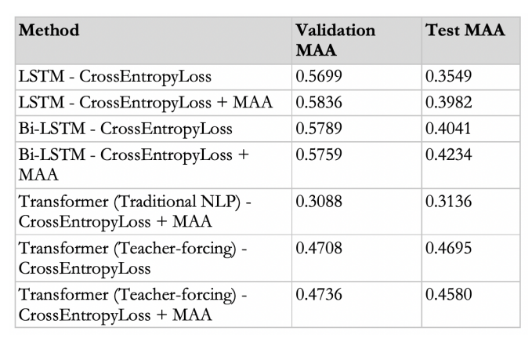
Error Analysis
Starting with the results of baseline, we see that the Gradient Boosted Trees (GBT) model achieves 0.51620 subset accuracy on our data. It is important to note that the way we passed input into this model is different compared to our other models, since GBT was meant to be an initial, simple test. Thus, we believe GBT may be achieving around 50% accuracy due to random guessing about whether a track is skipped or not skipped.
Below is a datatable with the rest of models’ accuracies (Source from paper)
LSTM and Bi-LSTMs both overfit to the data since the validation MAA is higher than the test MAA. This could be fixed by more rigorous hyperparameter tuning, which we focused on carrying out for our best model: the transformers. Furthermore, we can see that the Bi-LSTM performs slightly better than the LSTM, perhaps due to the
more detailed hidden encoder representation of the track sequence in the Bi-LSTM.

Slide 15
Discussion/Error Analysis
Gradient Boosted Trees achieves around 50% accuracy, more than the sequential based models,
perhaps because of random guessing and a large difference in this model’s architecture and input processing as compared to our other models
LSTM/Bi-LSTM: We can see that both of these models are overfitting to the data, which could be fixed by better hyperparameter searching and tuning. The more detailed internal representation of the sequence could account for why BiLSTM performs slightly better than LSTM.
Transformers (Traditional NLP): Based on the output, we can see that the transformer which we developed did not necessarily help improve accuracy. Mapping from an input size of 20 to and output size of 10 (tracks) may not be the best representation of the problem. While the sequential nature of data is modeled, the separation between the first half of the session and the second half of the session is less pronounced in this model, as all tracks are sent together.
Transformer (Feature-Forcing): Having the encoder represent the meaningful information about the first half of the session and having the decoder pay attention to both the representation of the first half and the individual audio features for each given track it was predicted proved to be a better model architecture for the
problem at hand. One source of information loss is that the output predictions from the decoder are not incorporated in as inputs for the next sequential prediction, as we are substituting with the track’s audio features instead.

Slide 16
Conclusion & Future Work
Before the results of the proposed method are presented, we introduce the result of a baseline model. The baseline model uses the skipping behavior of the last track in the first half as the prediction for all the tracks in the second half. This model scored 0.537 on MAA and 0.742 on First prediction accuracy. Predictions from the proposed model in this paper resulted in an MAA score of 0.604 and First Prediction accuracy of 0.792 on the hold-out set, thus achieving the seventh position in the competition.
Improve Transformer model: Dynamically append the output prediction for each track from the decoder with the track’s audio features and inject an embedding of this into our decoder
Have our models work with variable length tracks
Feature analysis and explainability for the Transformer: This will help us better understand how the attention layers work in the model and which features are more significant for prediction

Slide 17
Only around 20% of the data was used for training the model because of resource constraints. Instead, training the model on 80% of the data (leaving 20% of the sessions for validation and test sets) might improve accuracy.
During the exploration phase, a Random Forest (RF) model was built to predict the first track of the second half. Another RF model was trained to predict the last track in the second half. This model was built using the session log features until the last track, which is unlike the setup of this challenge where session log features are only available for the first half. Both the models achieved similar levels of accuracy. This reveals that fundamentally, user behavior during the end of the second half is not much more variable (and thus not harder to predict) than during the beginning of the second half. If complete data is available until the previous track, then any session position can be predicted with reasonable accuracy.
In the absence of complete data, we can try to generate predictions for missing features by building a model that predicts those features. Hence if a model was trained to predict all types of user interactions (skip_1, 2, and 3, hist_user_behavior_reason_start, and other remaining features), it is possible that the resulting model might be better at predicting skip_2. Similar to the proposed model in this paper, this model can use the previous time step’s predictions while predicting the current time step.
Another option is to employ transfer learning. Transfer learning has been useful in many areas, with one prominent example being the use of ImageNet-trained models[6]. As described in the previous paragraph, we can build and train a model to predict all the user interaction features available in the data. Such a model theoretically would have inferred more aspects of the user behavior than a model that is solely trained for skip_2 prediction. We can then fine-tune the top layers of this model specifically for skip_2 resulting in better skip_2 prediction accuracy.

Slide 18
ACKNOWLEDGMENTS
“ We want to thank WSDM, Spotify, and CrowdAI for organizing the challenge. Special thanks to Google for providing the coupons for using Google Cloud Compute resources. Considering the large size of the dataset, the coupons were especially helpful “
REFERENCES
[1] Brian Brost, Rishabh Mehrotra, and Tristan Jehan. 2019. The Music Streaming Sessions Dataset. In Proceedings of the 2019 Web Conference. ACM.
[2] Kyunghyun Cho, Bart Van Merriënboer, Dzmitry Bahdanau, and Yoshua Bengio. 2014. On the properties of neural machine translation: Encoder-decoder approaches. arXiv preprint arXiv:1409.1259 (2014).
[3] Kyunghyun Cho, Bart Van Merriënboer, Caglar Gulcehre, Dzmitry Bahdanau, Fethi Bougares, Holger Schwenk, and Yoshua Bengio. 2014. Learning phrase representations using RNN encoder-decoder for statistical machine translation. arXiv preprint arXiv:1406.1078 (2014).

